Slide 1
VAX TRACK v1 - Remastered
Vivek Kumar | Associate Consultant | Infosys

Slide 2
AGENDA
Introduction
Application Overview
Roles & Permission
Pages & Functionalities
Workflow Diagrams
Architecture & Database Design
Challenges & Solutions
Future Enhancements
Conclusion

Slide 3
INTRODUCTION

Slide 4
CASE STUDY
The COVID-19 pandemic has highlighted the critical need for efficient and accessible vaccination systems. To address this, we have developed a web-based application using the ASP.NET MVC framework. This application aims to streamline the vaccination process by providing a user-friendly portal for both normal users and administrators.
The primary purpose of this vaccination portal is to facilitate the booking and management of COVID-19 vaccination slots. The objectives include:
Simplifying the registration and booking process for users.
Providing administrators with tools to manage vaccination slots and user approvals efficiently.
Ensuring secure and accurate tracking of vaccination statuses.

Slide 5
APPLICATION OVERVIEW
The vaccination portal is designed to cater to two types of users: normal users and administrators. Normal users can register, log in, and book vaccination slots, while administrators have additional functionalities to manage the overall vaccination process. The application ensures a seamless experience.
Key Features and Functionalities
User Registration and Login: New users can register and log in to the portal. Successful registration leads to auto-login and redirection to the user profile page.
User Profile Management: Users can view and update their profile information and check their vaccination status.
Slot Booking: Users can book available vaccination slots. The status changes from ‘not vaccinated’ to ‘vaccinated’ once approved by the admin.
Admin Dashboard: Administrators have access to a dashboard displaying total users, users yet to book slots, users with pending approvals, and available slots in hospitals.
Approval and Slot Management: Admins can approve vaccination statuses and update the number of available slots in hospitals.

Slide 6

Roles & Permissions
Tasks | User Role | Admin Role
Registration
Login
Slot Booking
Access User Profile Page
Access Dashboard Page
Approve Booked Slot
Update User’s Vaccination Status
Update Available Slots Count in Listed Hospitals

Slide 7
PAGES & FUNCTIONALITIES

Slide 8
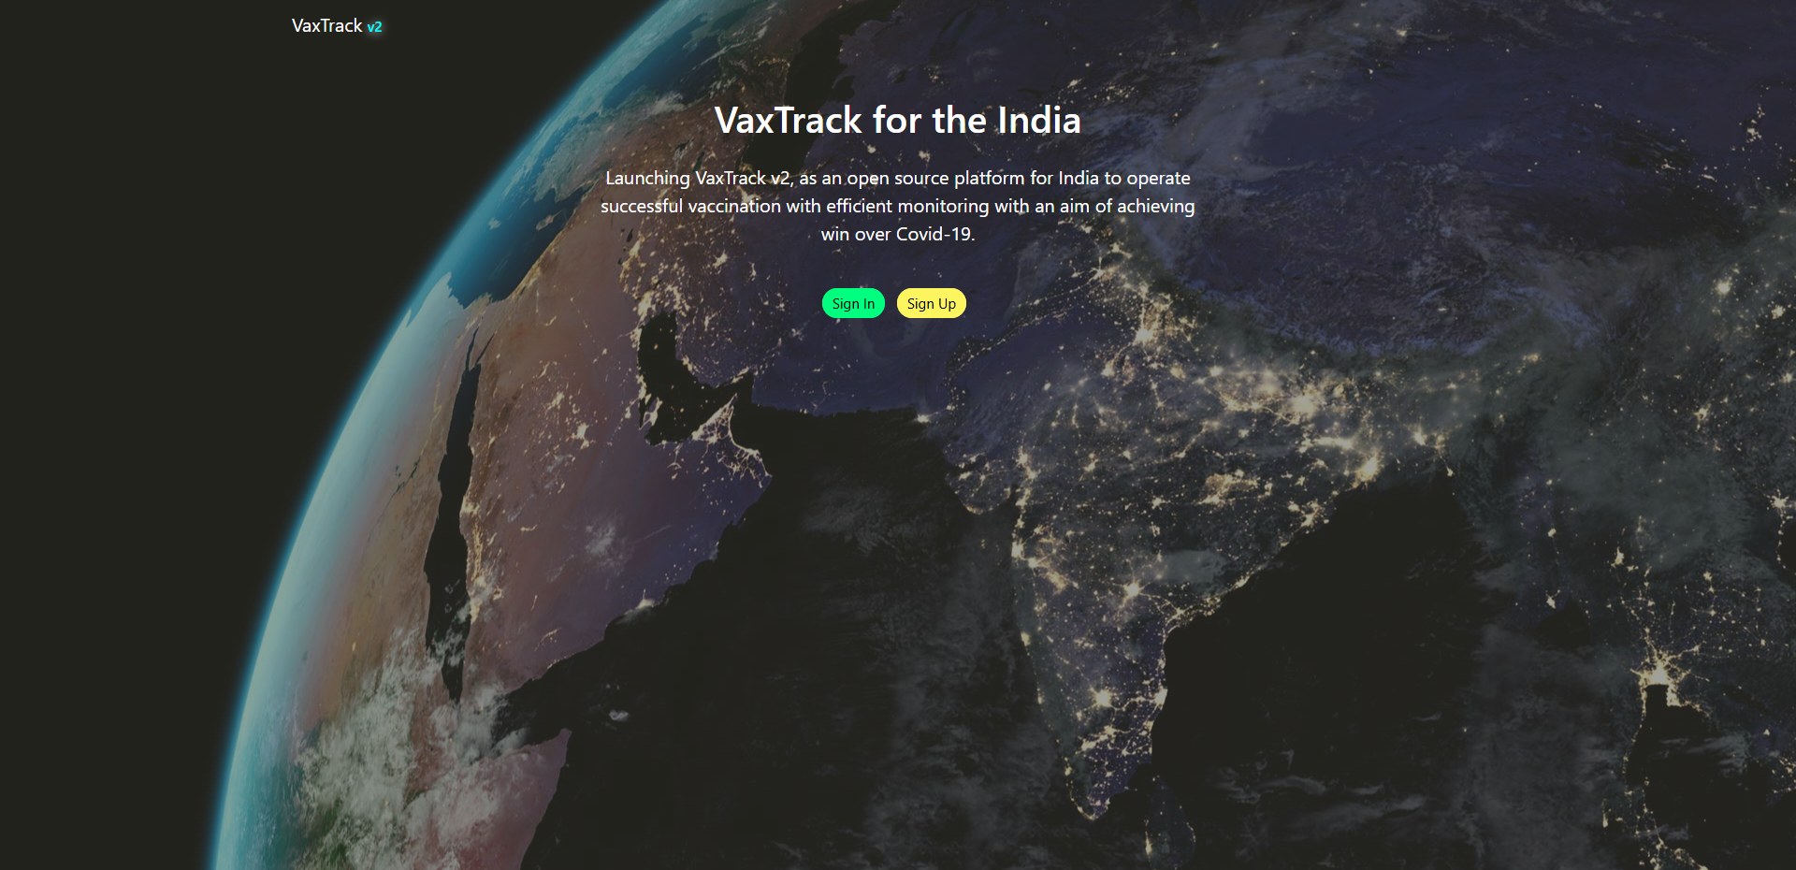
HOME PAGE

Slide 9
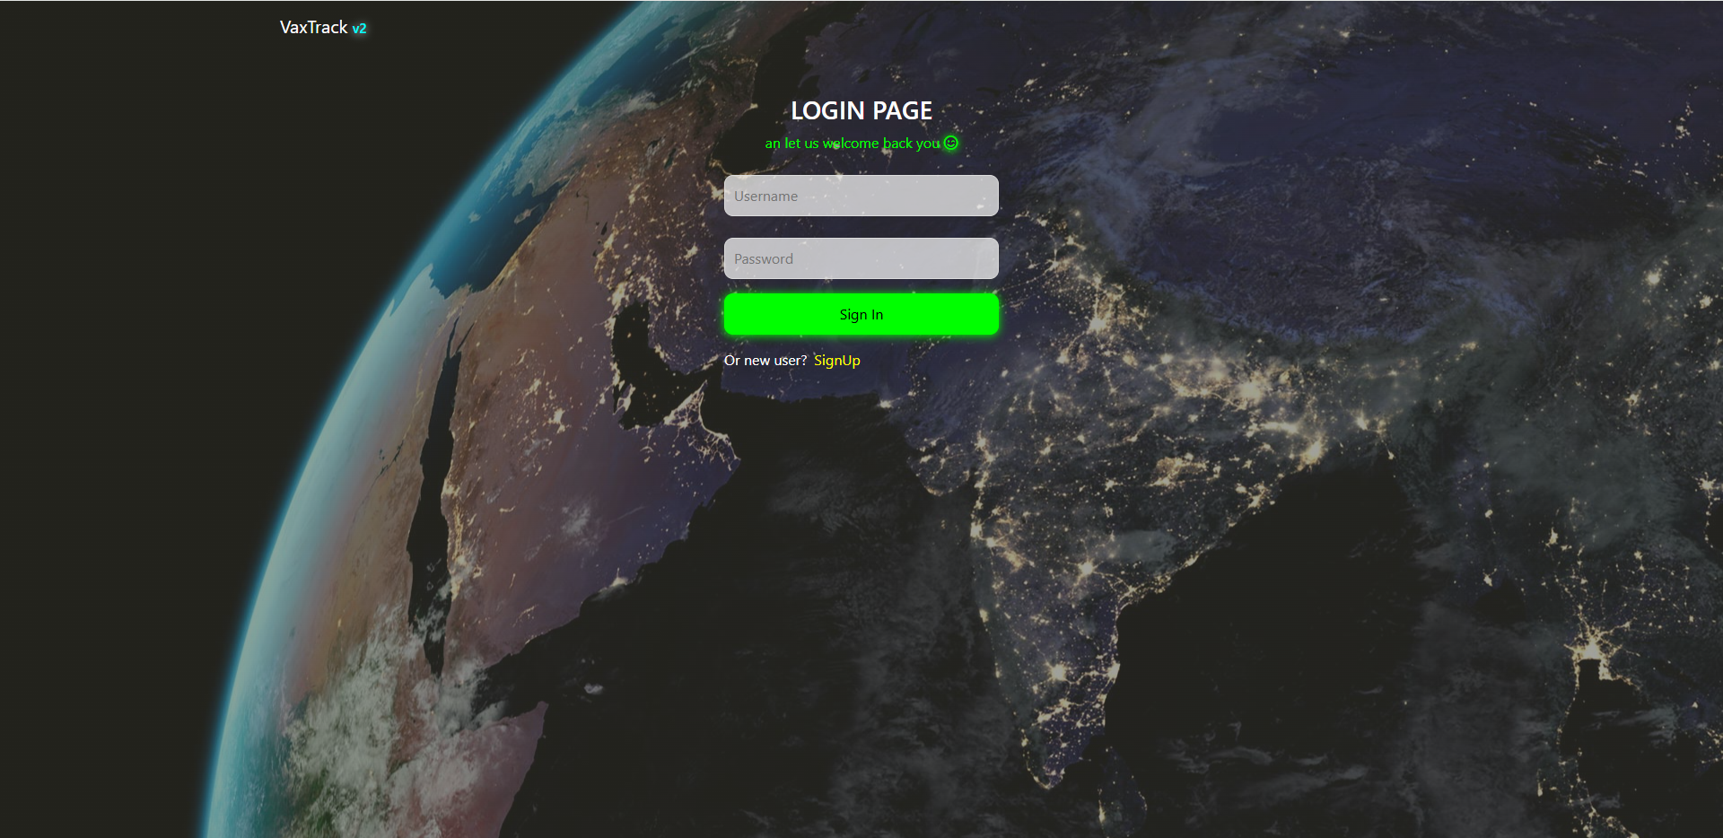
LOGIN PAGE

Slide 10
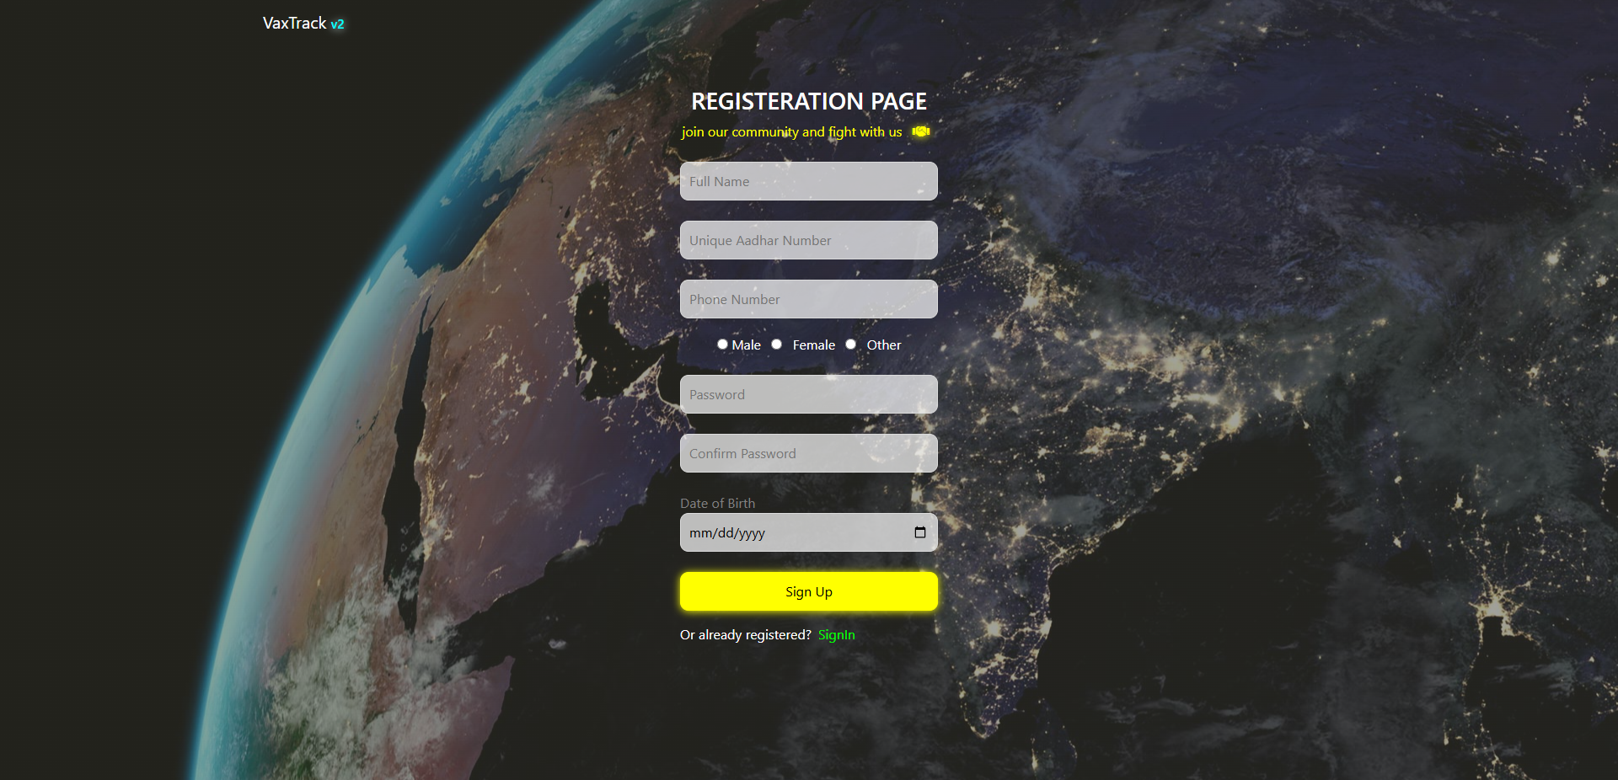
REGISTRATION PAGE

Slide 11
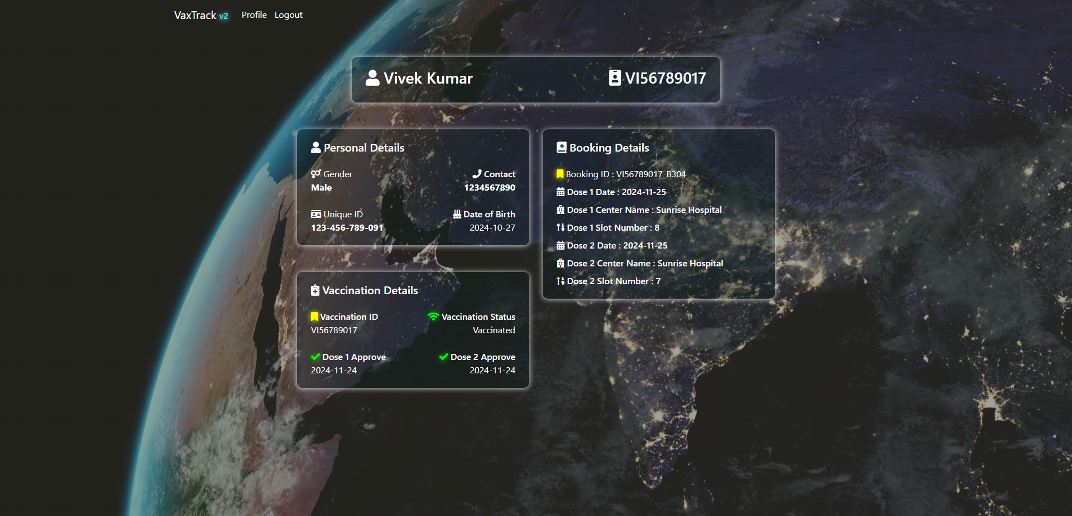
USER PROFILE PAGE – VACCINATED

Slide 12

USER PROFILE PAGE – PENDING APPROVAL

Slide 13
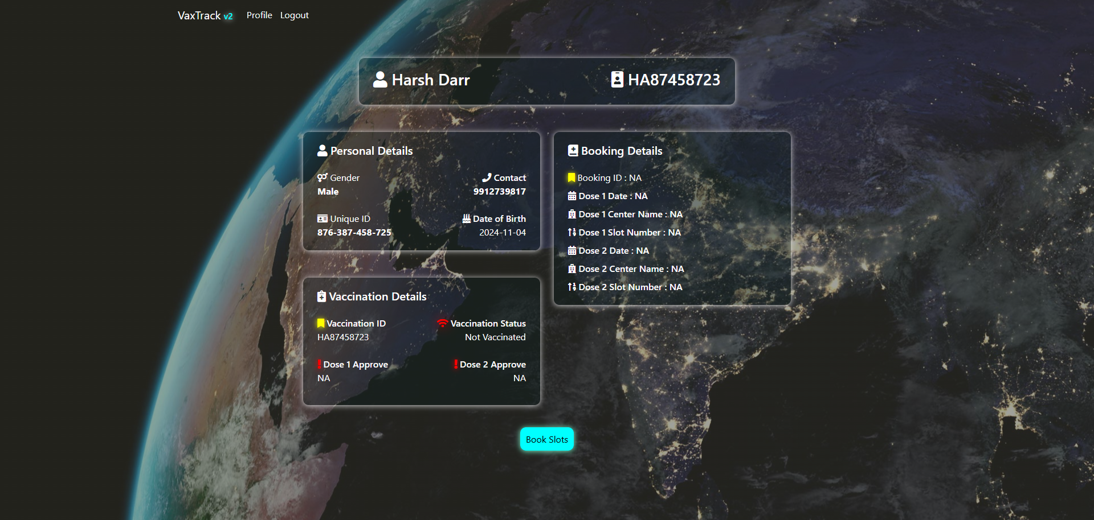
USER PROFILE PAGE – W/O BOOKED SLOT

Slide 14
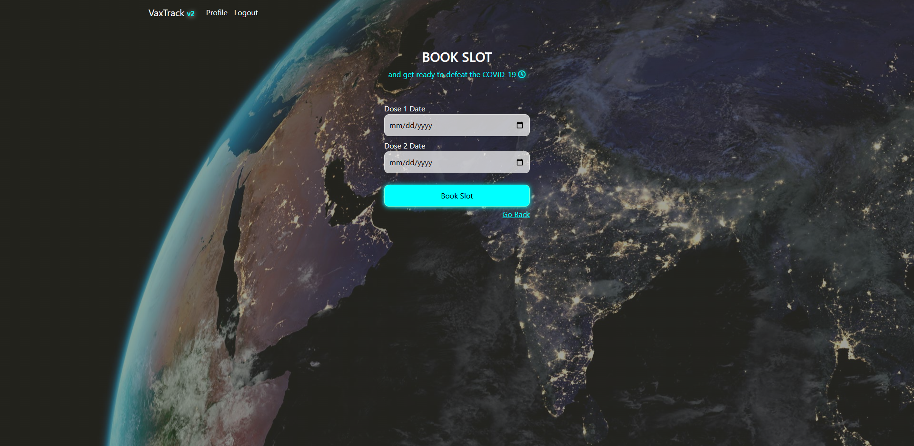
SLOT BOOKING PAGE

Slide 15
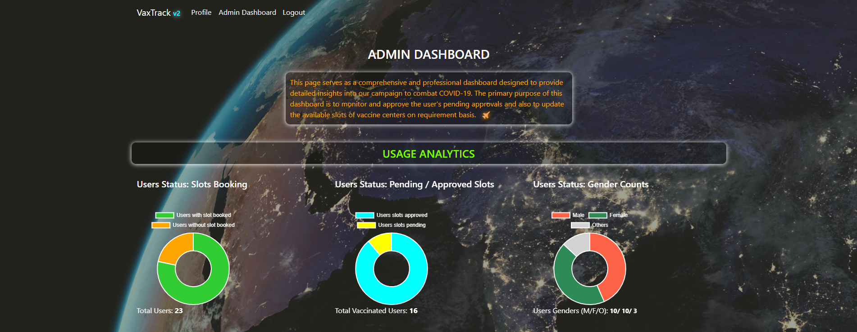
ADMIN DASHBOARD – USAGE ANALYTICS

Slide 16
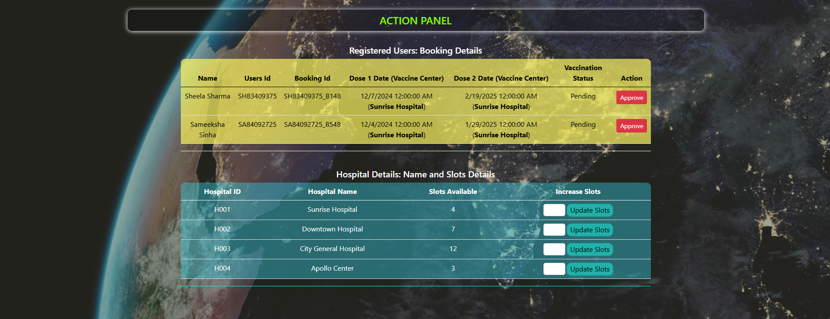
ADMIN PAGE – ACTION PANEL

Slide 17
ARCHITECTURE & DATABASE DESIGNS

Slide 18
ARCHITECTURAL DESIGN
Login & Registration Page
Admin Dashboard Page
Home Page
User Profile Page
Booking Page
Presentation Layer
Home Controller
Account Controller
User Profile Controller
Booking Controller
Admin Controller
Account Service
User Profile Service
Booking Service
Admin Service
Business Logic Layer
Auth Service
User Vaccine Details Service
Hospital Service
User Details DTO
Booking DTO
Admin DTO
Data Access Layer
User Vaccine Details DTO
Hospital DTO
User Details Model
User Vaccine Details Model
Booking Details Model
Database Layer
Hospital Model

